Slide 1
Gait Fitness Function Formulation
Design of Control System for Quadruped using Central Pattern Generators
Shreyas Shandilya

Slide 2
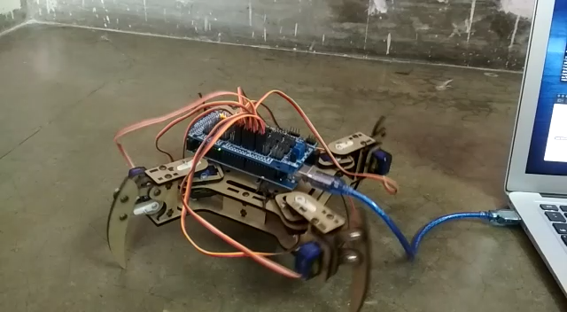
Robot walking Video
Observe the tendency of the robot to topple towards the swinging leg

Slide 3
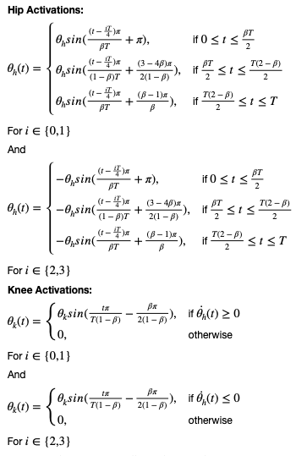
Gait Pattern
Pattern in use and problems with it
This Gait Pattern obtained from the formulation in the figure is for a creep walk of the quadruped
The robot walks with this Gait Pattern
But the stability of the quadruped is not maintained
The quadruped tends to topple towards the leg in swing phase

Slide 4
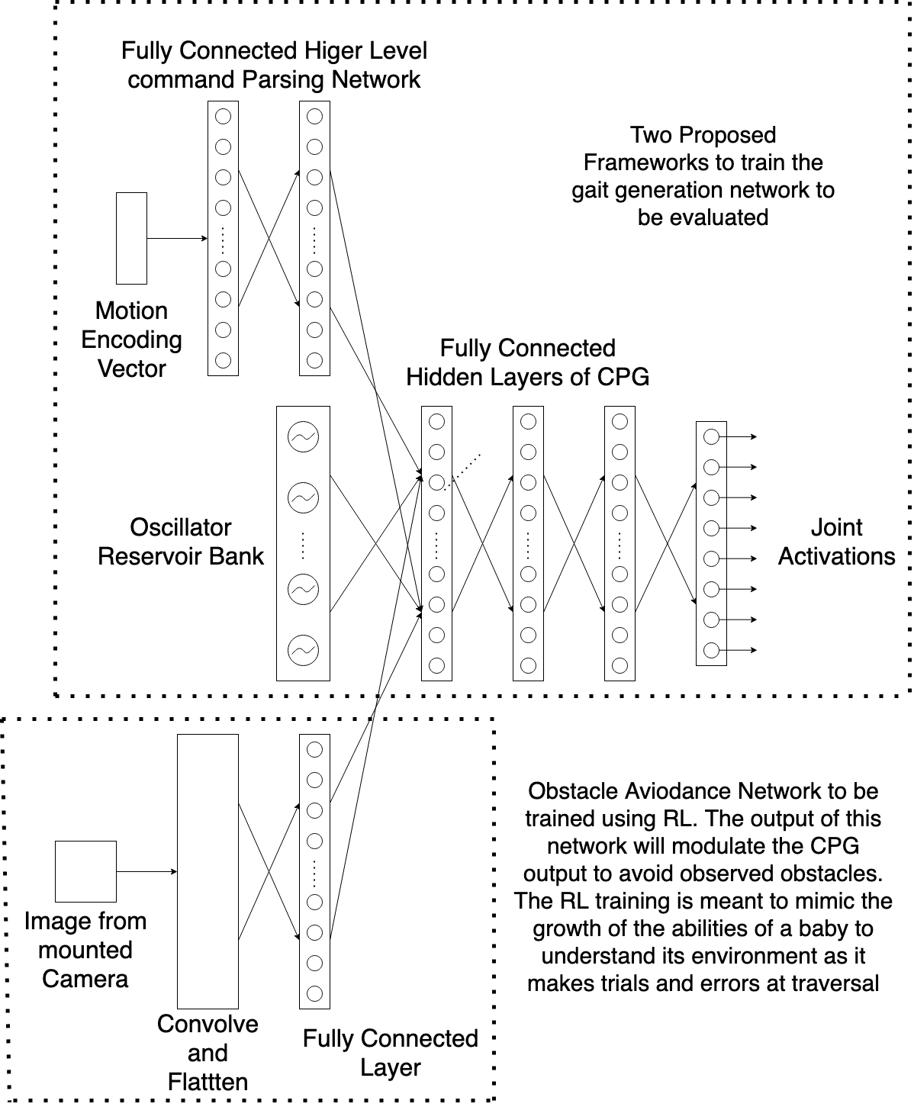
Architecture
Proposed solution to ensure gait stability
Two methods Proposed to train the gait generation network
Train the gait generation network end to end using back props and then use RL training for improvement of gait
Optimise Gait Patterns using fitness function, then train the network end to end using back prop

Slide 5
Fitness Function
Evaluation Criteria to measure stability, speed and energy consumption
Both the aforementioned training frameworks require a Fitness Function [1]
Fitness Function must measure the following
Stability Criteria, $S$
Speed Criteria, $V$
Energy Efficiency Criteria, $E$
$F=\overset{t}{\underset{i=t-T}{∑}}S_{i}^{k_{s}}V_{i}^{k_{v}}E_{i}^{k_{e}}$ where
F is the Fitness Value
$k_{s}$, $k_{v}$ and $k_{e}$ are integer parameters to account for relative importance of each criteria
T is the gait period and t is the current time instance

Slide 6
Stability Criteria
Evaluation of Dynamic and Static Stability of the Quadruped
A Quantitative Measure of quadruped’s dynamic stability
The Criteria must not only take into account current stability but must also anticipate the stability at the next time instance, given the state of motion of the quadruped, like an animal does
Yan Jia, Xiao Luo and others [2] in their paper propose a modified ZMP based stability evaluation criteria
The main idea is that at a certain state, the motion of the robot is considered to be stable if the torque caused by the ground-reaction force can prevent the robot from tumbling around any support boundary

Slide 7
Stability Criteria
Virtual Support Plane and Modified Zero Moment Point
The paper assumes that a robot is stable if the current or next set of support feet can provide the moment necessary to prevent the robot from tipping in any direction
A Virtual Support Plane is proposed and it is proposed that if the modified ZMP proposed in the paper lies within this Virtual Support Plane, then the robot motion will be stable
The Proposed Modified ZMP in the paper also includes a velocity term to account for the motion of the quadruped

Slide 8
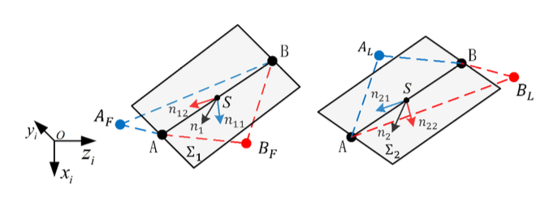
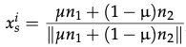
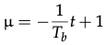
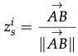

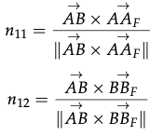
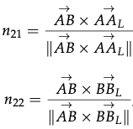
Stability Criteria
Calculating the Virtual Support Plane
S is the origin of the support coordinate system on which the ZMP will lie
$n_{1}$ is the normal vector to the plane $AA_{F}BB_{F}$
$n_{2}$ is the normal vector to the place $AA_{L}BB_{L}$
$x_{s}^{i}$, $y_{s}^{i}$ and $z_{s}^{i}$ are the normal vectors to the virtual support plane in the inertial frame of reference
$T_{b}$ is the duration between two adjacent steps and t is the time gap between the current running time and the time point when the previous support line disappeared

Slide 9
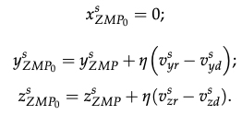
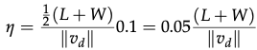
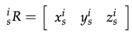
Stability Criteria
Calculation of Modified Zero Moment Point
Zero Moment Point is the point at which the resultant moment on a body is zero
Modified Zero Moment Point should-
Assess the current stability more efficiently and accurately
Provide a reference to eliminate undesired velocity during motion planning
$ZMP_{o}$ can be used to compute 3 measures of dynamic stability
Equations to calculate modified ZMP in support coordinate system. $v^{s}$ and $v^{d}$ are the actual and expected velocities in support coordinate system
L and W are the effective length and width respectively of the quadruped
Rotation Matrix for transformation from support to inertial coordinate system

Slide 10
Stability Criteria
Calculation of the metric $S$
The following three choices for $S$ can be calculated using $ZMP_{o}$-
Distances between $ZMP_{o}$ and the boundaries of the virtual-support quadrilateral in the support plane
Angle between the vector pointing from CoM to $ZMP_{o}$ and the normal vector of the virtual support place
Distance between $ZMP_{o}$ and the support line
The assumption in the paper that the legs have negligible weight compared to the rest of the body does not hold for the quadruped used
There is a need for evaluation of the repercussions on the concepts introduced

Slide 11
Speed and Energy Criteria
Calculation of metrics $V$ and $E$
Speed Criteria measures the discrepancy between expected and actual speed
$$V=vT_{b}/d$$
Where $v$ is the actual speed and $d$ is the distance travelled over period $T_{b}$
Energy Criteria measures the energy efficiency of the quadruped
$$E=mv^{2}/2T_{b}W$$
where $m$ is the mass of the quadruped, $W$ is the power supplied to the quadruped, $v$ is the actual velocity and $T_{b}$ is the fixed period used in $V$

Slide 12
References
Masuri, Ariel; Medina, Oded; Hacohen, Shlomi; Shvalb, Nir (2020) ‘Gait and Trajectory Optimization by Self-Learning for Quadrupedal Robots with an Active Back Joint’
Jia, Yan; Lua, Xiao; Han, Baoling; Liang, Guanhao; Zhao, Jiaheng; Zhao, Yuting (2018) ‘Stability Criterion for Dynamic Gaits of Quadruped Robot’
Kramer, Oliver; Gong, Daoxiong; Yan, Jie; Zuo, Guoyu (2010) ‘A Review of Gait Optimization Based on Evolutionary Computation’

